Slide 1
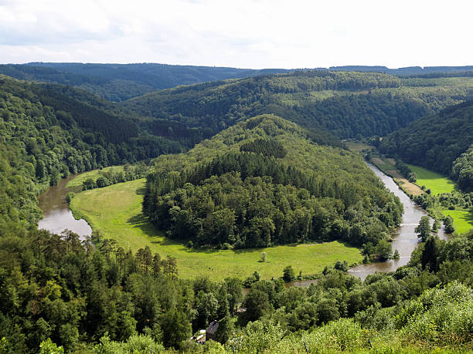
Bootcamp Ardennes
Kim, Emmanuel, Miguel, Elwin, Timo, Kimberley, David

Slide 2
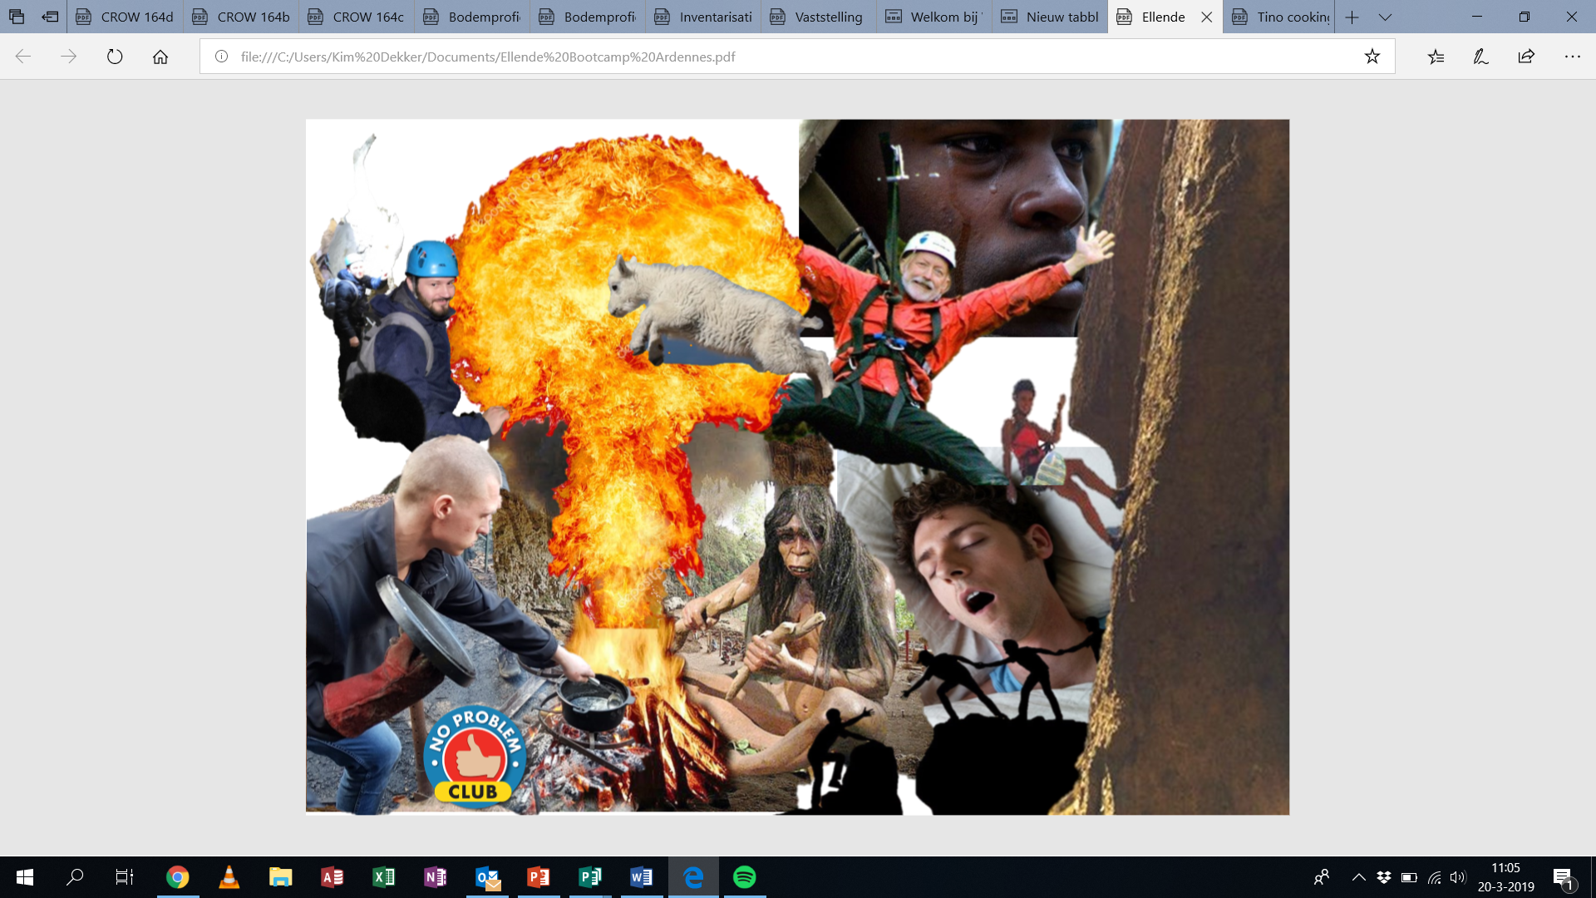

Slide 3
